Slide 1


Hii,
Iam Siddhika
Welcome to Power BI Series
Part -64

Slide 2



I’m very excited to dive into this with you all!
Are you ready to enhance your data visualization skills?
We focus only on the most used and important Visuals
Today Content
VISUALIZING DATA
GAUGE CHART
VISUALS - RANKING
RIBBON CHART

Slide 3
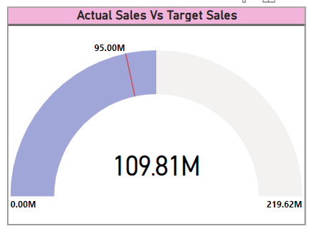


GAUGE CHART
A
gauge
chart
(or
gauge
Go and
explore
visualization)
is
used
to
formatting
represent progress
towards
a
of GAUGE
goal or a single
value
within
a
chart
quantitative
context.
It
is
shaped
like
a
dial
or
a
speedometer and
provides
a
quick
visual representation
of
how much of a goal has been
achieved.
Key Features:
The line (or needle) represents the goal or target value.
The shading represents the progress toward that goal.
The value inside the arc represents the progress value

Slide 4


GAUGE CHART
When to Use:
Performance Tracking: To track progress toward a specific target, such as sales goals or completion percentages.
Single Metric Focus: To highlight a single key performance indicator (KPI) with an easy-to-understand visualization.
got it?
Threshold Indicators: To show whether a value is within acceptable, warning, or critical ranges by using different color zones.
Purpose:
Quick Overview: Provides a quick overview of a single KPI. Performance Monitoring: Allows for real-time monitoring of key metrics against predefined targets.
Visual Impact: Offers a visually impactful way to see progress and performance.

Slide 5
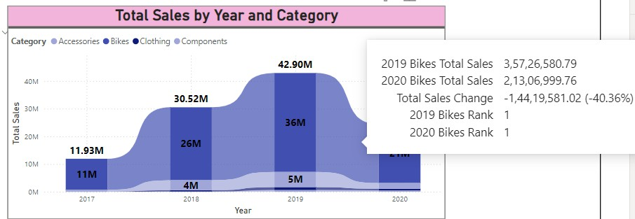

RIBBON CHART
Go and explore formatting of RIBBON
Chart
A ribbon chart shows rank change over time for different categories, helping you visualize how the ranking of categories changes over a continuous range, such as dates or periods.
When to Use:
Tracking Rank Changes: Ideal for visualizing changes in rank over time or another continuous range. Comparing Multiple Categories: Useful for comparing how different categories rise or fall in rank relative to each other.
Highlighting Trends and Patterns: Effective for identifying trends, patterns, and shifts in data ranking.

Slide 6


Thank you for joining me today to learn about Part -64 of Power BI!
Remember, Effective data visualization is crucial for turning data into meaningful insights and compelling narratives with Power BI.
Stay tuned for more insights and tips on Power BI in our next Series.
Follow
Siddhika Shah

